Slide 1

Eviction Diversion clinic- MACOMB County

Slide 2
What is Eviction diversion (EDP)?
A collaboration between social services agencies, DHHS, the HARA, legal services agencies, and the courts to reduce the number of evictions in their community.
Goal is to keep individuals and families housed.
  Homeless Prevention
  Reduced costs to the community
  Landlords receive payment for rent due
All players at the table at the same time for a smooth process.
Eviction cases get dismissed and do not result in a judgment for eviction.
Agencies provide funds for tenants to landlords
EDP from the State of Michigan funding ends 12/31/20

Slide 3
Administrative and Executive orders Regarding Evictions
Executive Order No. 2020-134: Eviction Diversion program for COVID-19 related debtors.
Executive Order No. 2020-118: Temporary prohibition against entry to premises for the purpose of removing or excluding a tenant or mobile homeowner from their home (Eviction Moratorium).
Administrative Order No. 2020-17 – Priority Treatment and New Procedure for Landlord/Tenant Cases.

Slide 4
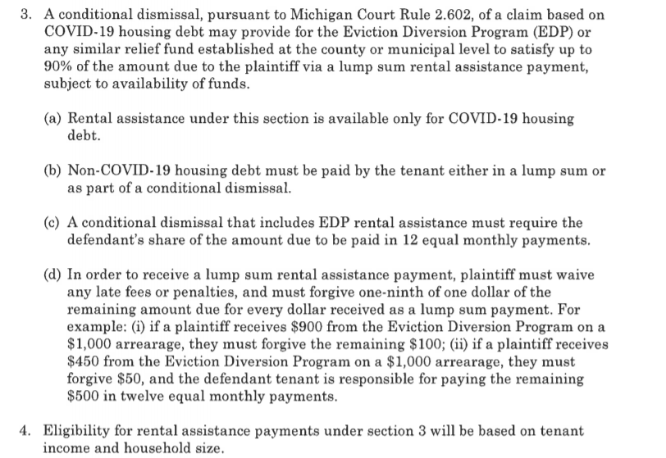
Executive order 2020-134 Section 3

Slide 5
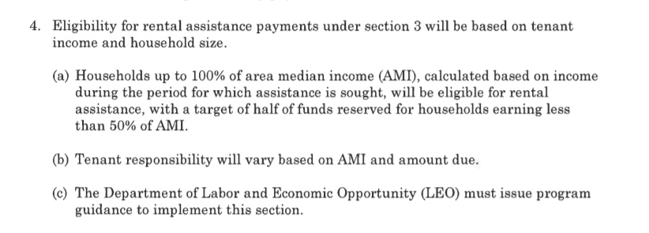
Executive order 2020-134 Section 4

Slide 6
Necessary Parties foR MACOMB edp
District Court Judges and Staff
Department of Health and Human Services
Macomb Community Action (CAA)
Macomb Homeless Coalition (HARA)
Lakeshore Legal Aid
Landlords and their attorneys

Slide 7
In a Perfect world…
Flyers that contain contact info for all agencies get sent with all summons
Tenant applies for SER and contacts the HARA prior to first hearing
Tenant applies for legal assistance prior to first hearing
Tenant attorney calls landlord attorney prior to court hearing to discuss settlement

Slide 8
In a Perfect world…
DHHS and Macomb Homeless Coalition provide rental assistance for tenant to landlord in an expedited manner
Conditional dismissal is agreed upon at first hearing
There is a reduction in the number of cases that need to appear before the Judges
Landlord gets money
Tenant gets to stay in the home, no eviction is on record
Case is dismissed

Slide 9
What doeS the hara NEED?
The HARA will administer funds to landlords on behalf of tenants using grant funds according to Executive Order 2020-134, sections 3 & 4.
Tenants who are in need of rental assistance due to missed payments during the state of emergency or state of disaster. March 10, 2020- July 16, 2020 at 11:59pm.
Tenants with a summons (per Administrative Order No. 2020-17 a judgment is not required).

Slide 10
What doeS the hara NEED?
Tenants who have already applied for SER through DHHS?
An intake process during court proceedings to screen tenants eligible for funds.
Tenants’ income and asset information.
Time to process rental assistance for landlords.

Slide 11
What do Legal SERVICES AGENCIES NEED?
More staff
Resource flyer served with summons
Court dockets in advance
First hearings scheduled as pre-trials
Low income (below 200% of poverty level) tenants to complete legal services intakes as soon as possible

Slide 12
What do Legal SERVICES AGENCIES NEED?
Court referrals to legal services when the tenant appears without an attorney.
Virtual Hearings with break out rooms for confidential discussions with clients. Safe physical space when the court re-opens.
Quick access to know if rental assistance payments will be made for their clients from the HARA and DHHS.
Entry of conditional dismissals.
Housing placement referral agency for evicted tenants

Slide 13
What does dhhs need?
A copy of the summons for each applicant (per Administrative Order No. 2020-17 a judgment is not required).
Application for SER as soon as possible, preferably before the court hearing.
A referral process during court proceedings to screen tenants eligible for funds.
Tenants’ income and asset information.
Documentation from the Landlord or their attorney
Confirmation from tenant or social service agency of payment for the amount due that will not be covered by Covide SER funds
Time to process rental payments to landlords.

Slide 14
What do landlords need?
Understanding of the EDP process
Ability to electronically file cases
Simplified way to process cases
Minimal attorney fees to file and litigate cases
Cases steered towards settlement
Confidential breakout rooms during virtual hearings
Confirmation of approved rental assistance payments
Notes:
Will have to waive late fees and penalties and must forgive 1/9 of one dollar on remaining amount owed to collect the money from EDP (See EO 2020-134.

Slide 15
What do the court and judge need?
Minimized number of filings and settlement of cases
Legal and Social Service Resources flyer for litigants
CARES verification from landlords. SCAO Administrative Orders 2020-8, 2020-17(2)(h) and SCAO Form DC 504
Clear process for tenants who appear at the first hearing without an attorney.

Slide 16
What do the court and judge need?
Dockets that comply with phasing requirements. Amended Administrative Order 2020-17
Technology to hold virtual hearings.
Staff from each agency present and available during the eviction docket calls.
Clear process for getting documents, pleadings, and/or evidence to judge for virtual hearing.

Slide 17

Created by Kellie Maki Foster and Emily Calabrese of Lakeshore Legal Aid

