Slide 1
How to File Pleadings in Wayne County in the Electronic World
Hon. Kathleen M. McCarthy
Presiding Judge Family Division
Erin Lincoln- Wayne County Friend of the Court
Julia Perkins- Varnum Law
Liisa Speaker- Speaker Law
Referee Lauren Middleton- Wayne County

Slide 2
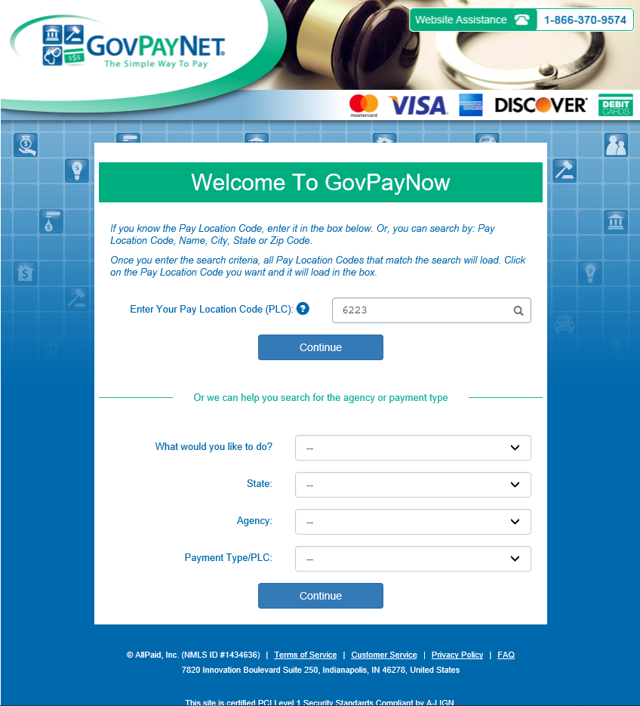
Payment of Filing
Go to www.govpaynow.com
Enter 6223 as the Pay Location Code (PLC)

Slide 3
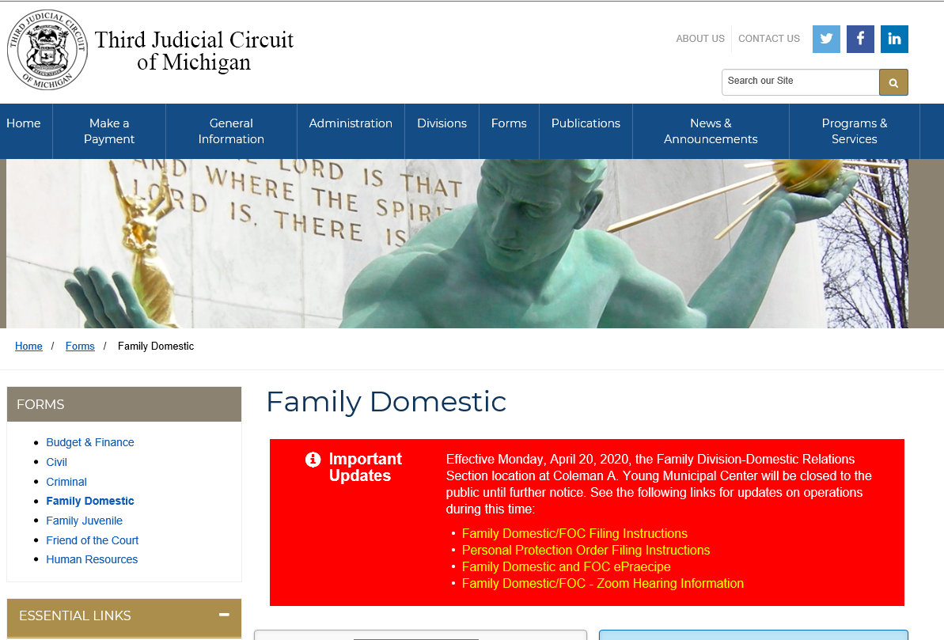

Slide 4
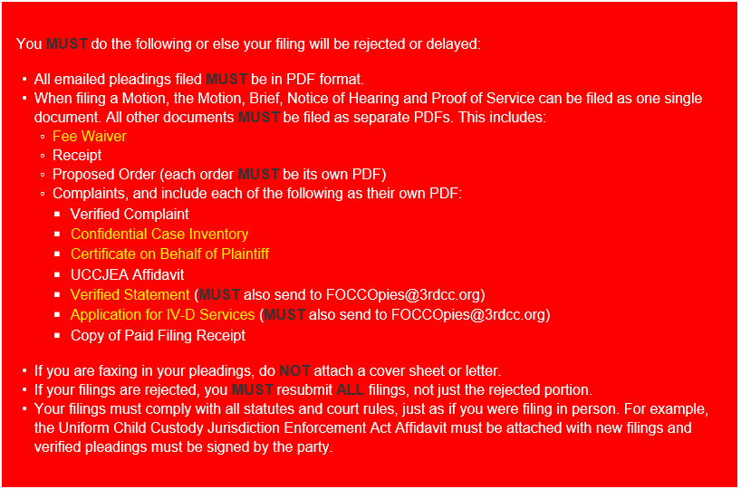

Slide 5
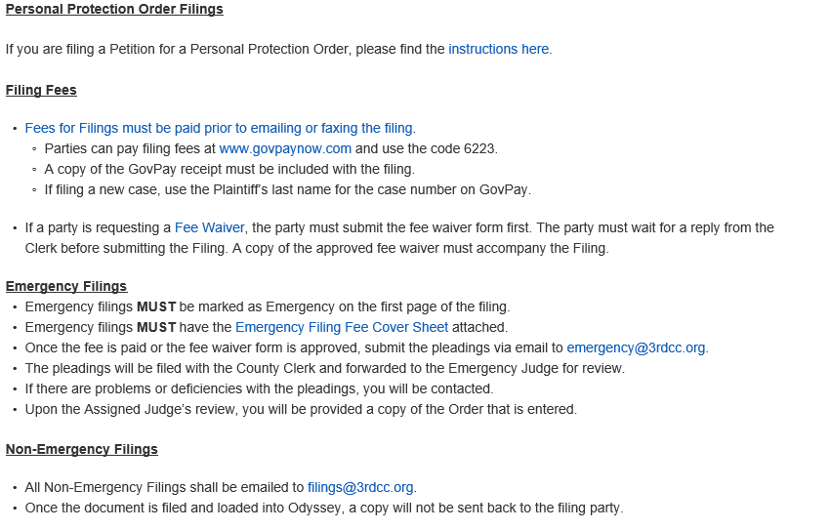

Slide 6
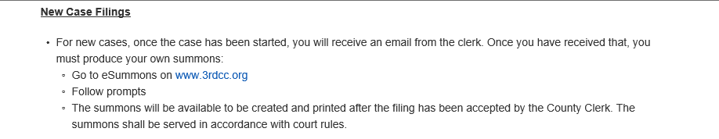

Slide 7
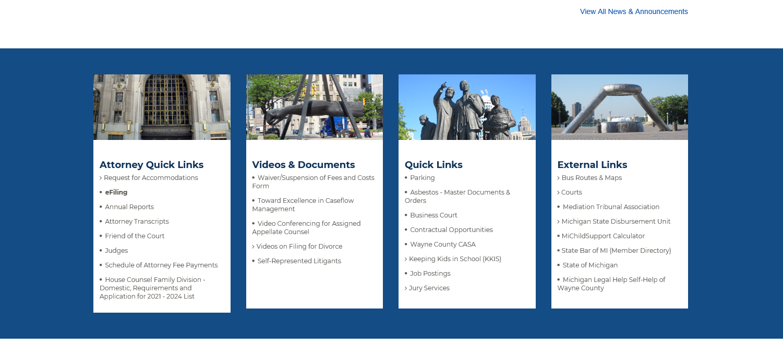


Slide 8
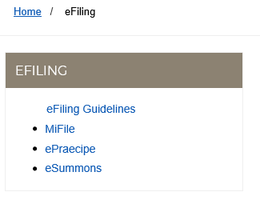

Slide 9
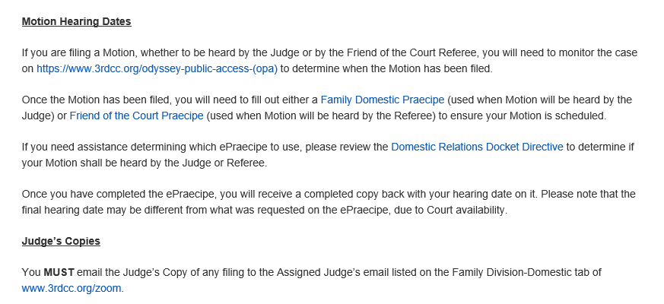

Slide 10
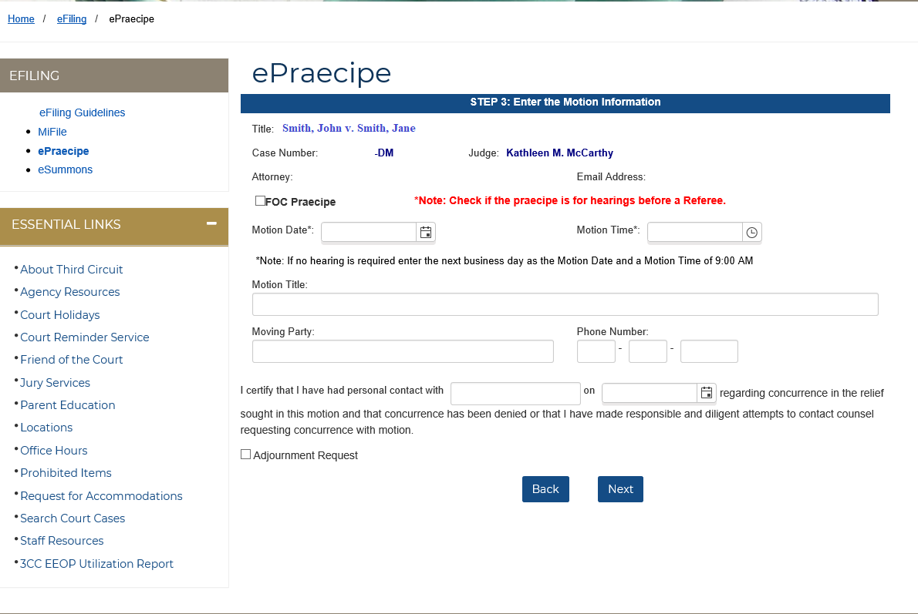

Slide 12
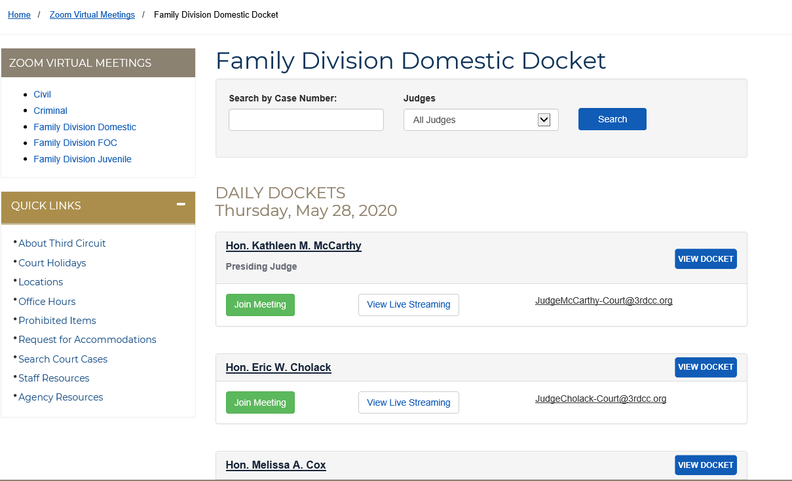

Slide 13


Slide 14
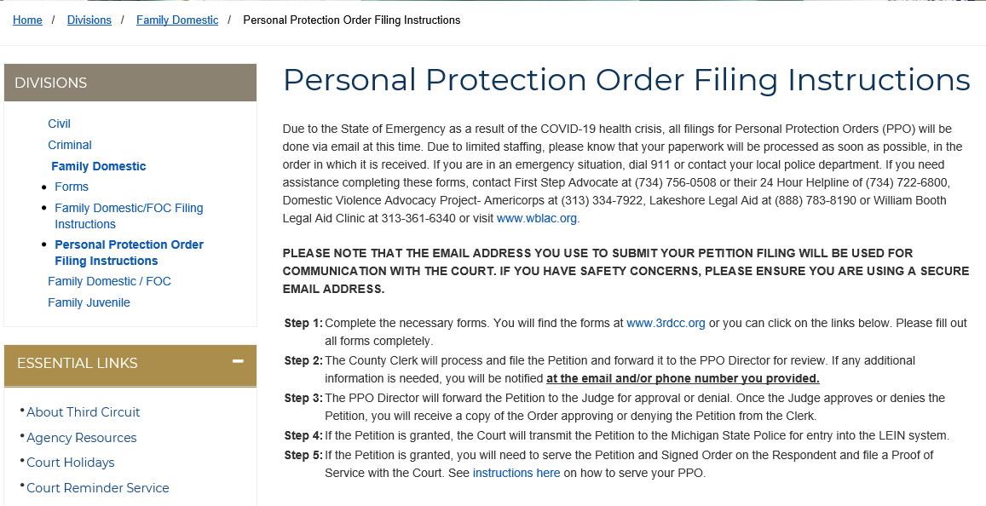

Slide 15
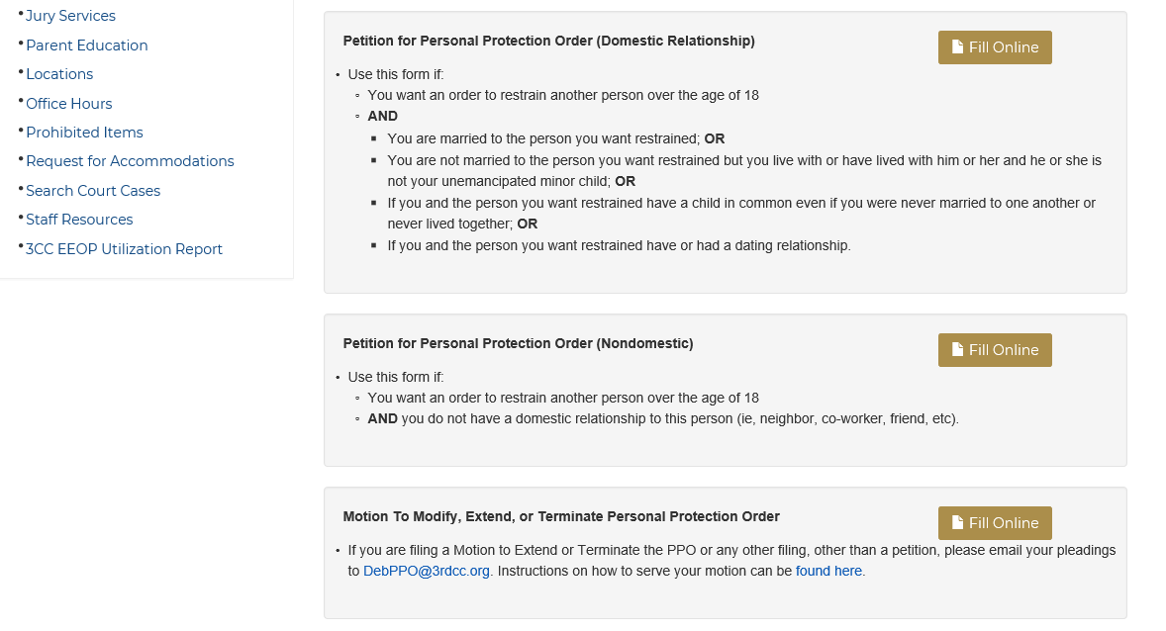

Slide 16
Questions?

